Slide 1


WNY
ENGINEERING & CONSTRUCTION MANAGEMENT
A pitch by Jose Vergara
February15, 2024

Slide 2


ABOUT ME
Civil Engineer with more than 30 years experience on construction.
I have training on handle people and communication, administrative and management skills.
The biggest project we had in 2012 was for US$1 million to rebuild country roads in Colombia.
Our US business has increased the gross income 20 times between 2019 - 2022.

Slide 3
OUR COMMITMENT
WNY E&C is a construction management company that has pride itself of very high-quality services in the community for commercial and residential projects in the Buffalo area since 2016.
Our commitment is to deliver high quality services in timely fashion to the complete satisfaction of our clients.

Slide 4
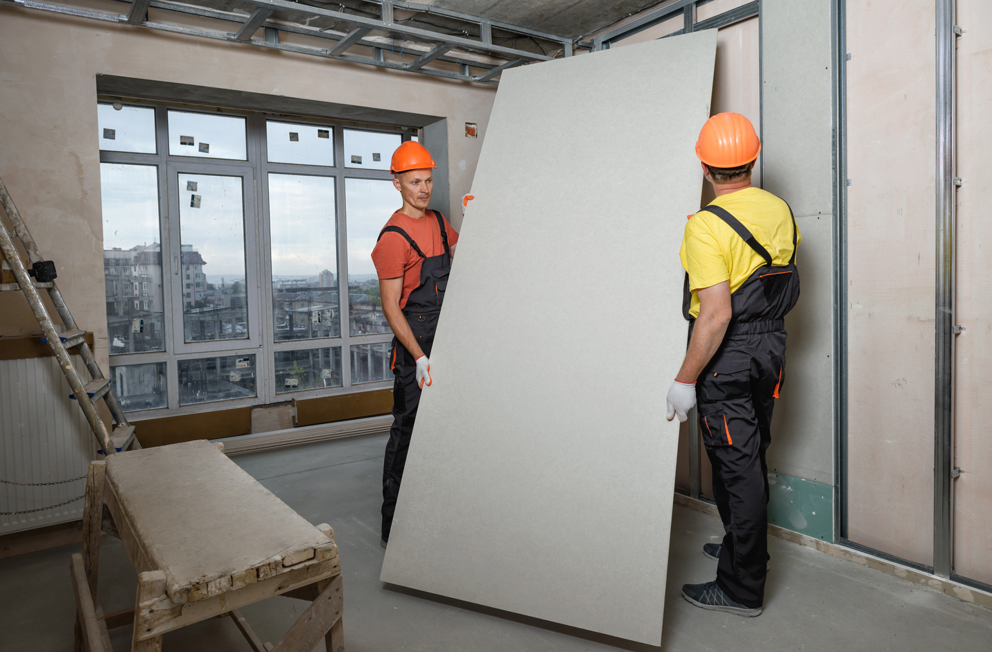
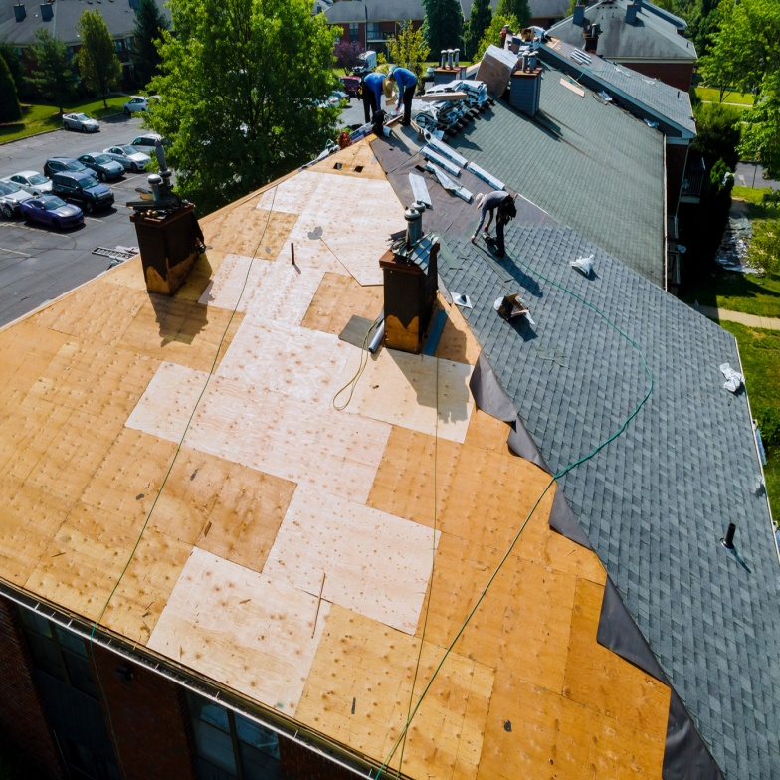
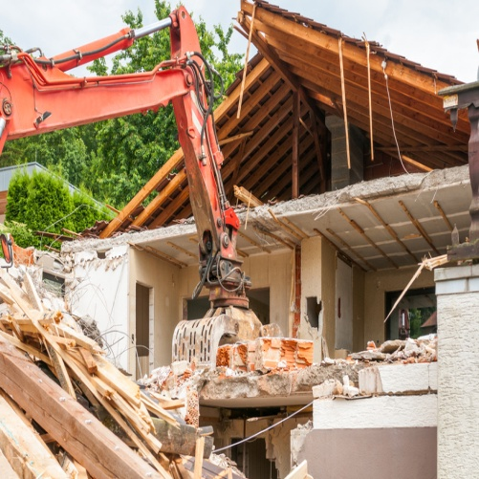


OUR SERVICES
Construction management
Interior demolition
Siding, framing & drywall
Flooring & carpeting
Painting
Concrete footings and driveways
Metal roof and repairs
Commercial renovations

Slide 5

OUR CREDENTIALS
MWBE Certification for the City of Buffalo and Erie County
City of Buffalo - Light Commercial Contractor LTC20-10057524.
City of Buffalo - Demolition Grade 1 DM120-10057525

Slide 6



PREVIOUS CLIENTS
Wegmans – Café Remodeling & Freezer relocation
Pike Inc – Flooring replacement
Community Action Organization (CAO) - Exterior painting.
Church of Scientology of Buffalo - Drywall repair, carpet install and painting.
Iglesia Metodista Libre West side Buffalo - Exterior brick replacement with metal siding.
Historical Residential House Downtown Buffalo - Renovation of 3 Stories
70+ residential jobs between 2021 and 2023 (in all trades)

Slide 7
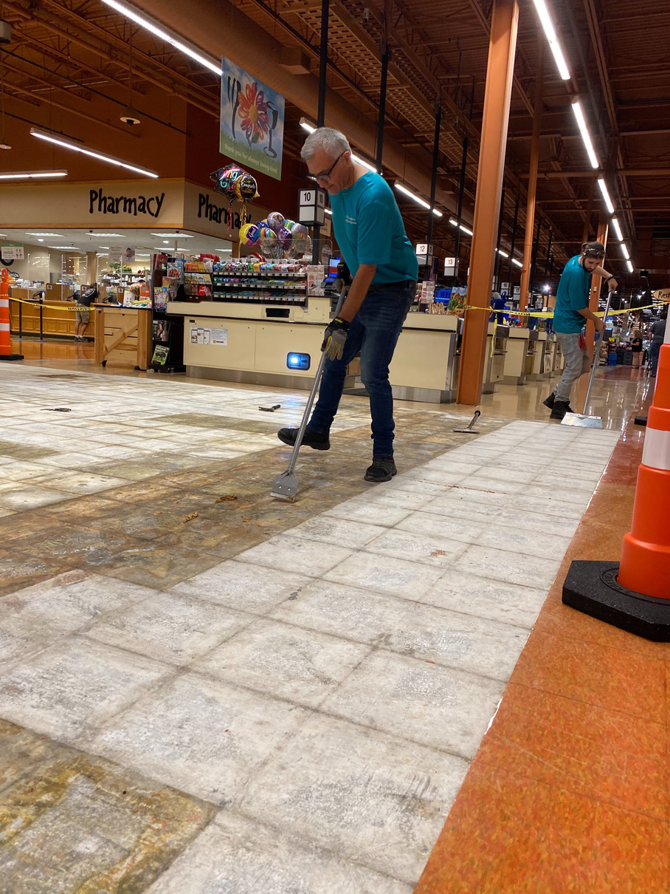
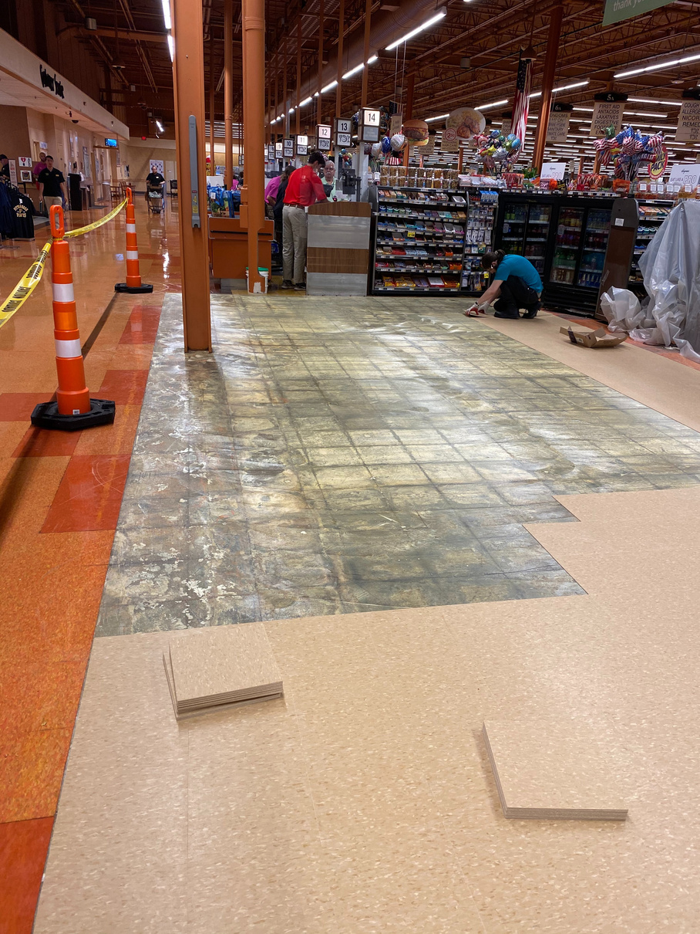
PREVIOUS PROJECTS
Floor replacement at Wegmans, Erie PA

Slide 8
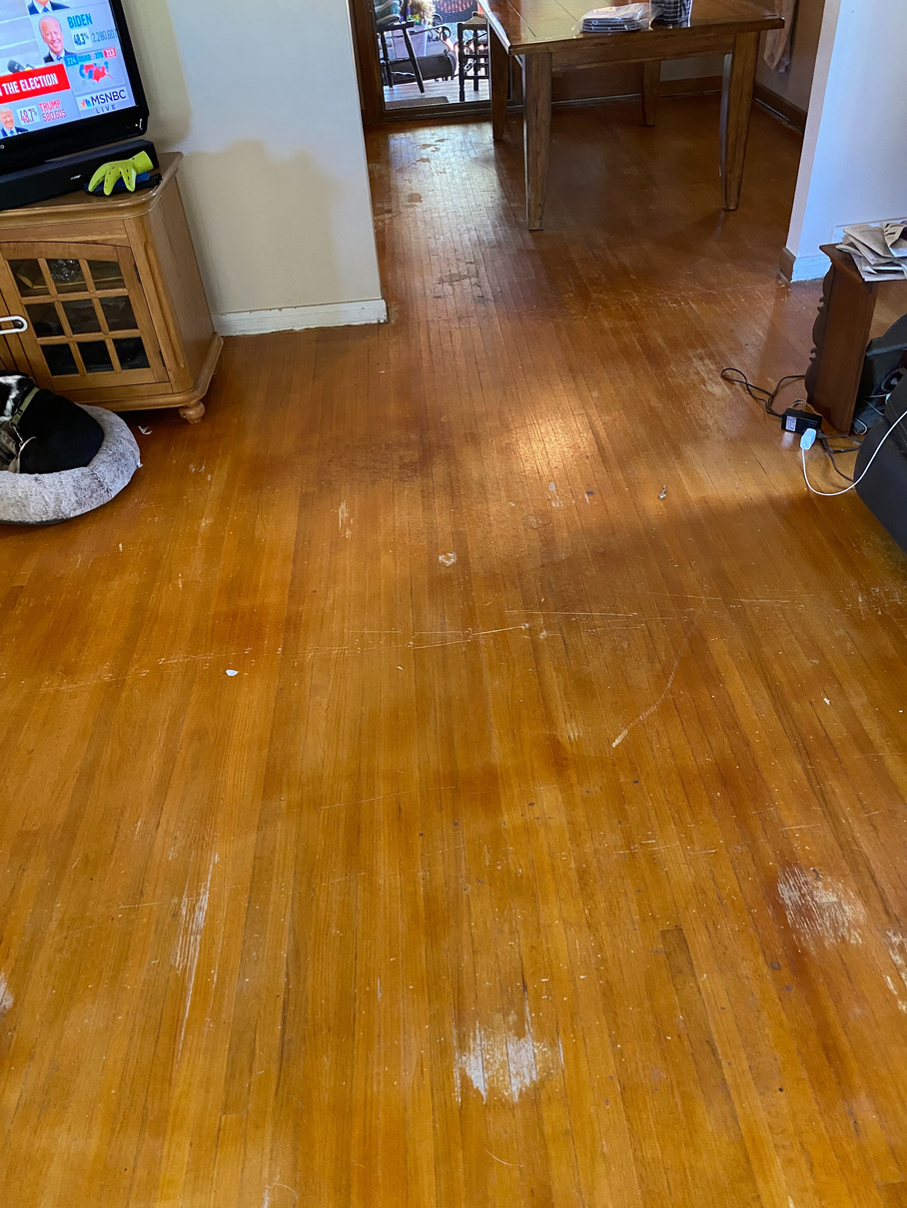
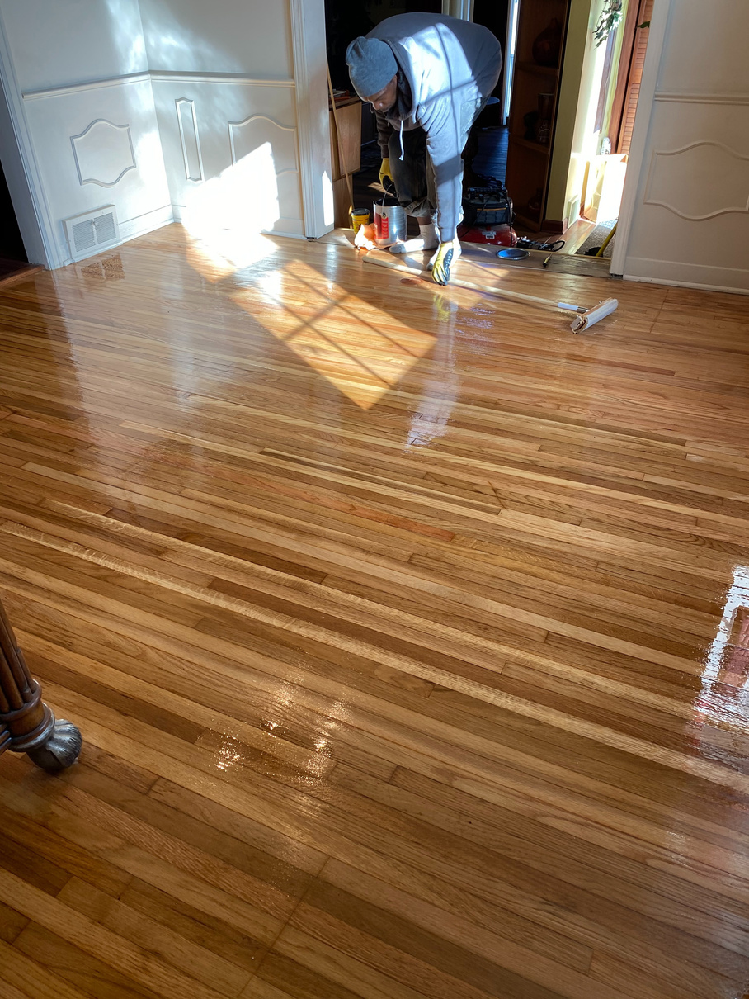
PREVIOUS PROJECTS
Wood floor finishing
BEFORE
AFTER

Slide 9
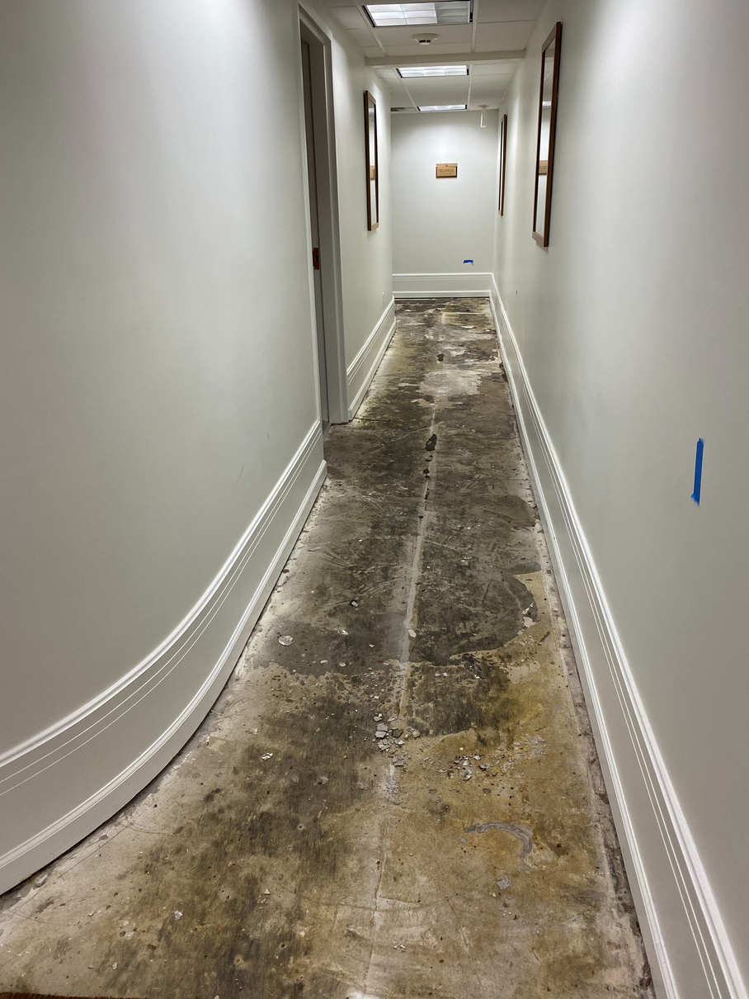
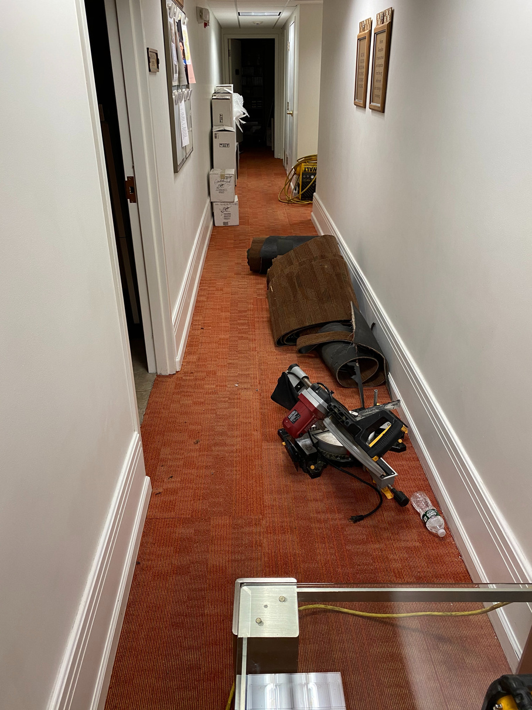
PREVIOUS PROJECTS
Carpeting upgrade in Church of Scientology
BEFORE
AFTER

Slide 10
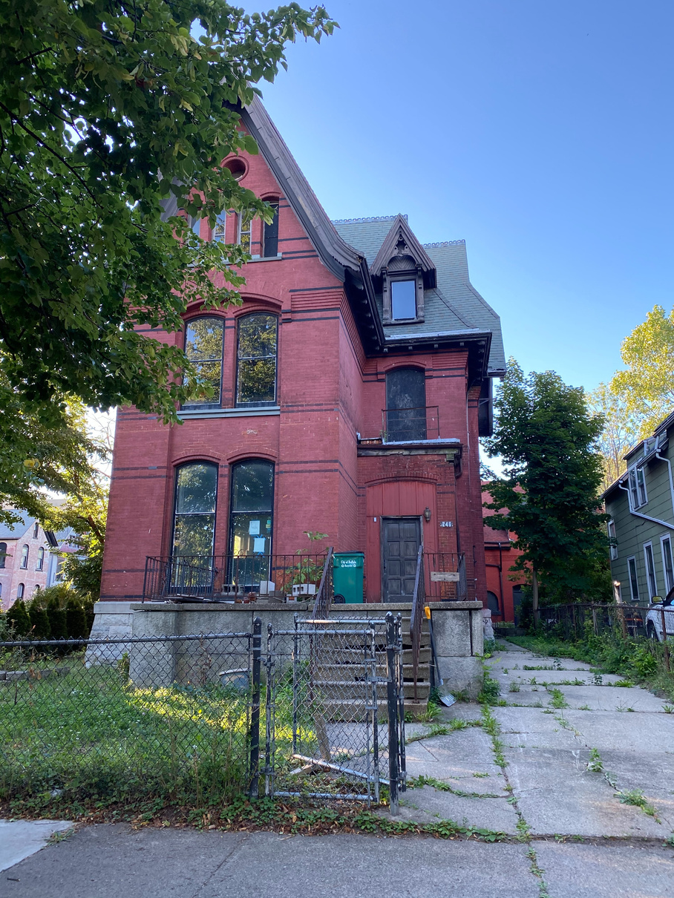
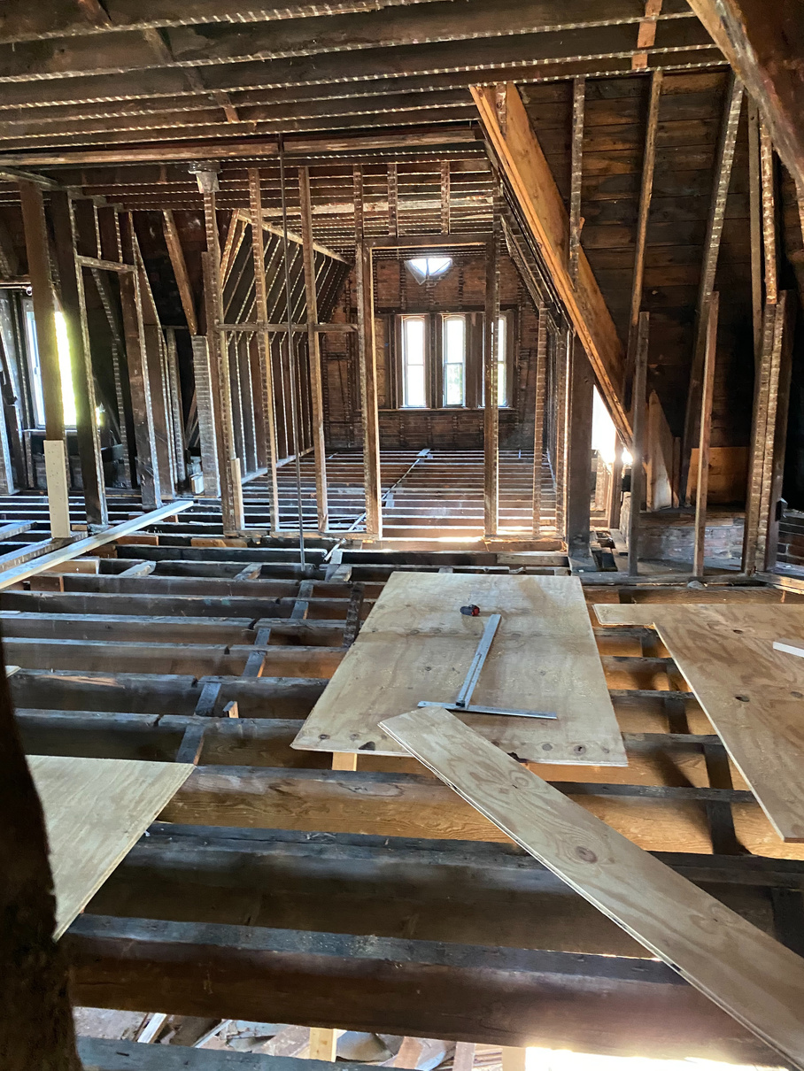
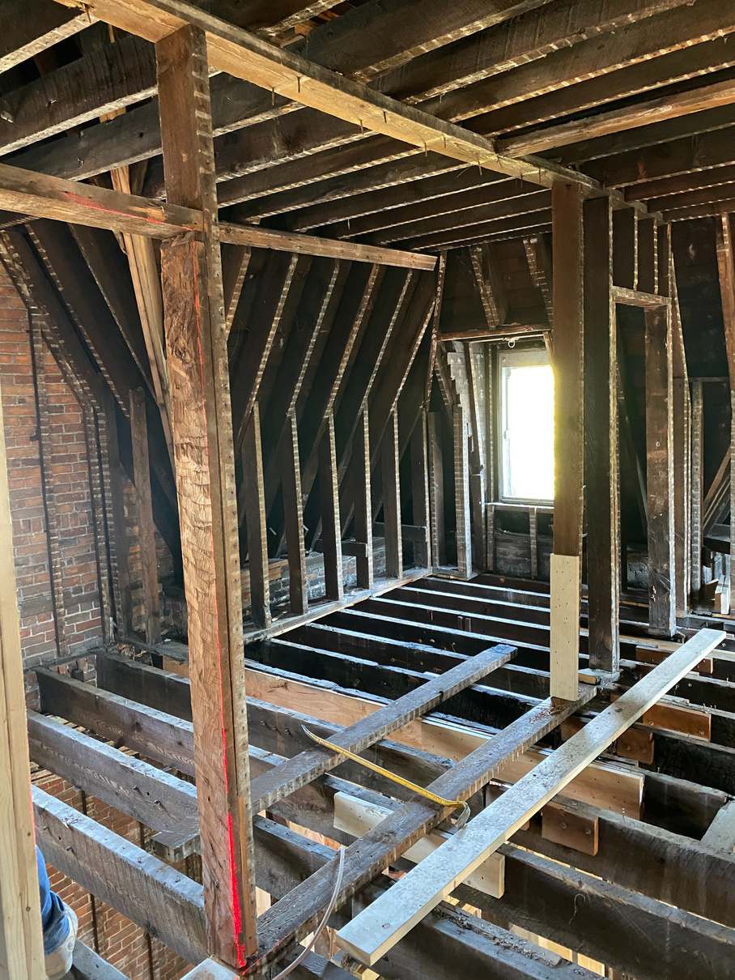
PREVIOUS PROJECTS
Complete Renovation Historical House

Slide 11
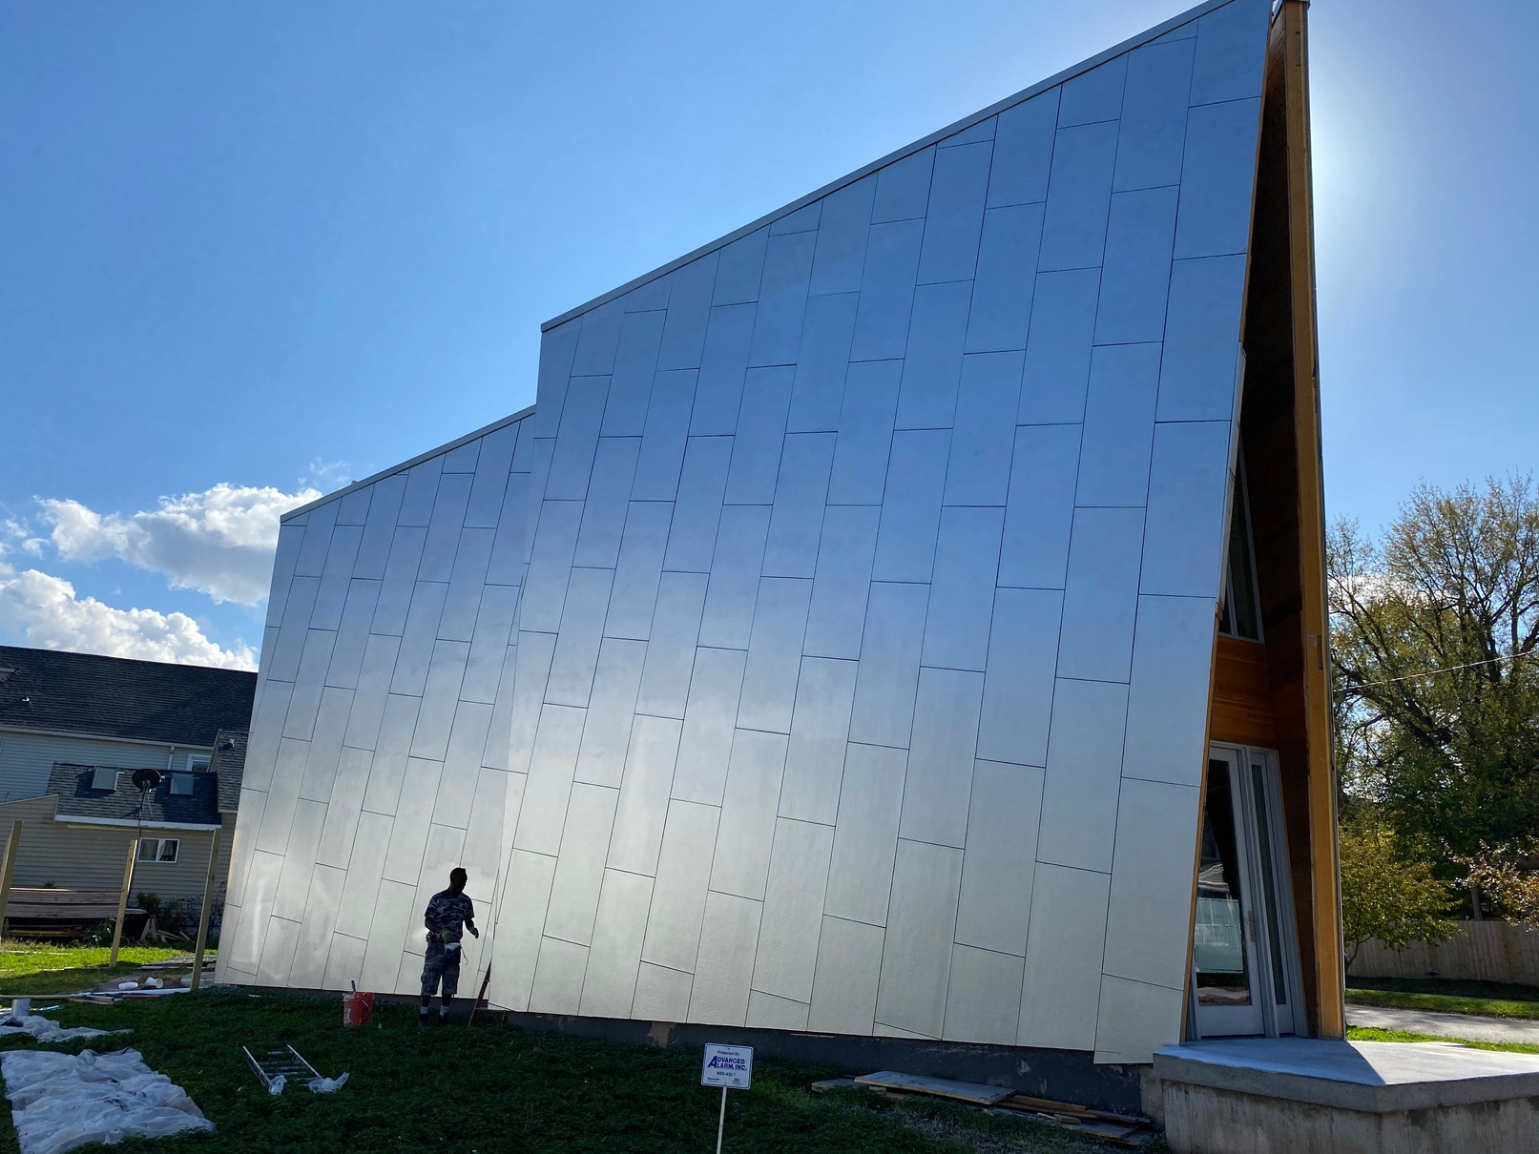
PREVIOUS PROJECTS
Exterior

Slide 12

TESTIMONIALS
Review by Donna E. in Buffalo, NY
Project: Install Drywall
Comments: I like working with Jose. He is always on time with his team and does what he says he will do. I would highly recommend WNY Engineering and Construction
Review by Jonathan L. in Buffalo, NY
Project: Demolish and Remove Structures
Comments: We had a fire escape removed and it was a very challenging job, that could have caused significant damage to our home if anything went wrong. Having an actual civil engineer (Mr. Jose Vergara) responsible for the project put my mind at ease. They did the job perfectly. They were true professionals and I would recommend them without reservations.

Slide 13
TESTIMONIALS
Review by Mike H. in Tonawanda, NY
Project: Install Drywall
Comments: Jose and his crew were a pleasure to work with. Not only did they do a great job on the drywall, they also put in new hardwood flooring and a beautiful staircase. Very happy with the price and workmanship.
Work Description: Interior Painting 3+ rooms
Comments: We had a large hole in our ceiling from a plumbing repair, and This company fixed the drywall and painted the ceiling. They also repaired some shelving holes in a few walls. Very professional and prompt. Great attention to detail and did high quality work. Our job was completed quickly, with care, and looks perfect-you can’t even see where the repair on the ceiling was! I was very impressed with Jose and his company, and I would recommend them highly.

Slide 14
WORK WITH US!
WNY
ENGINEERING & CONSTRUCTION MANAGEMENT
We provide an unparalleled construction services.
We are reliable, professional and friendly.

Slide 15
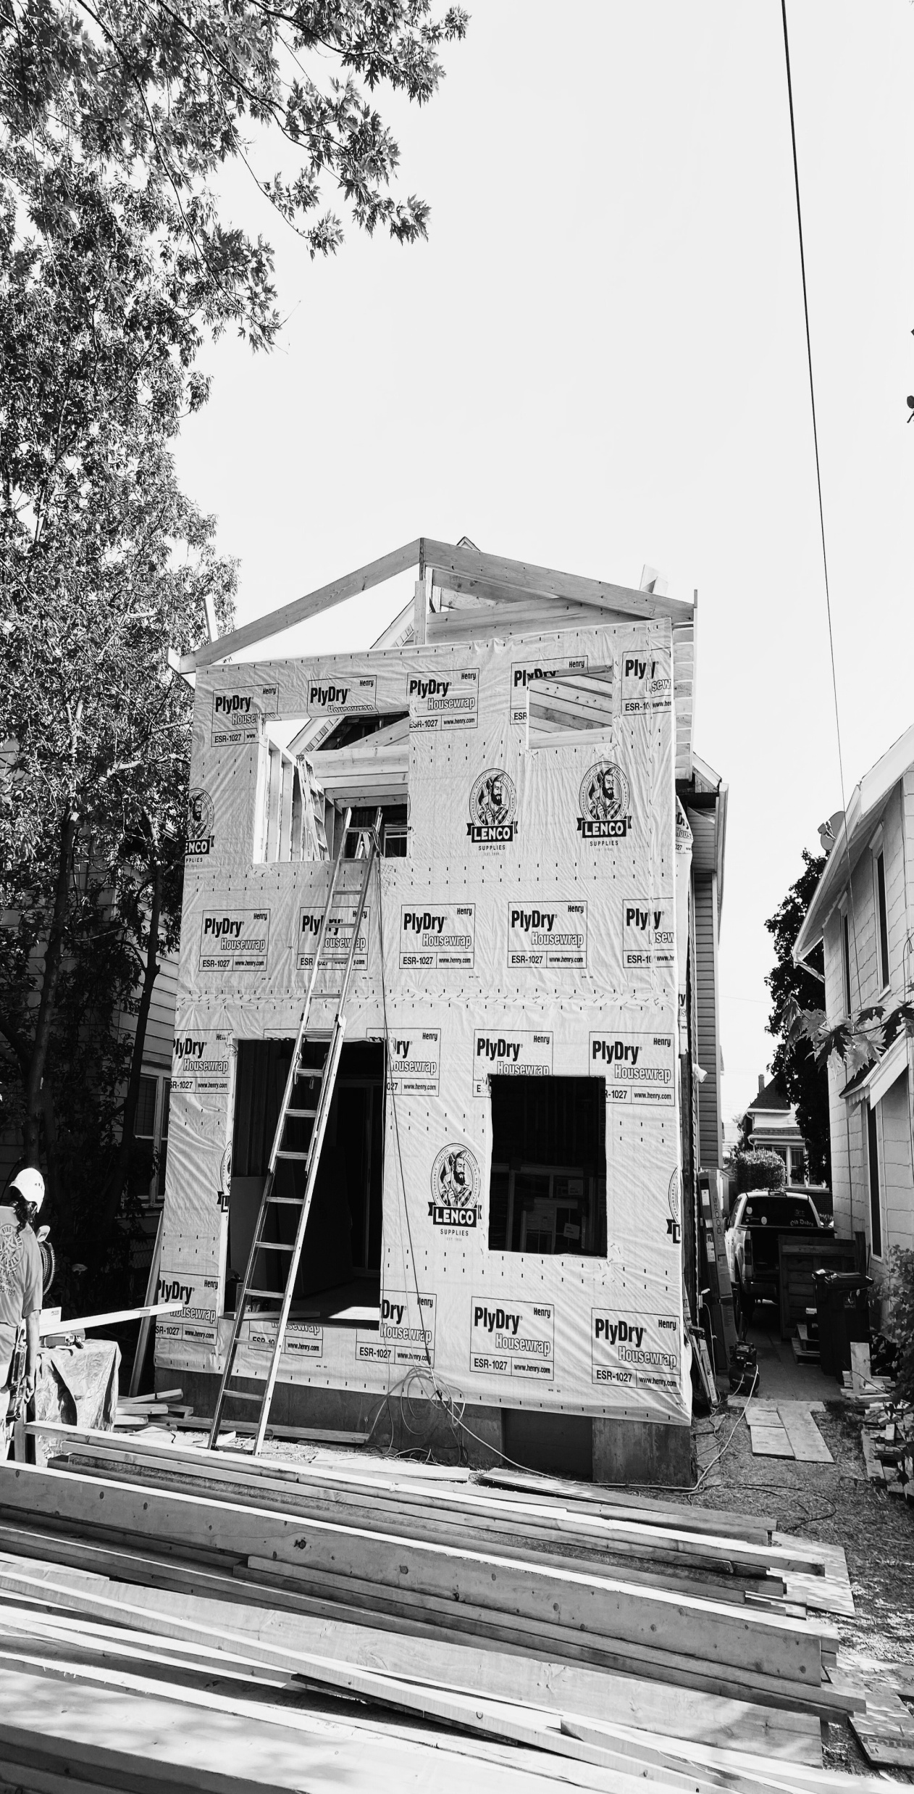



CONTACT US!
Jose F. Vergara
Phone: (716) 495-1875
josefvergara@wnyconstructionmgmt.com
Website: www.wnyconstructionmgmt.com

